Slide 1
Deep Reinforcement Learning (DRL)

Slide 2
Outline
Reinforcement Learning (RL)
Mokov Decision Process(MDP)
Q-Learning
Deep Q-Network (DQN)
Double DQN (DDQN)

Slide 3
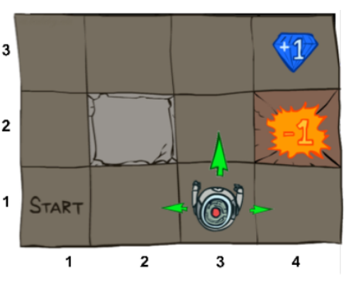
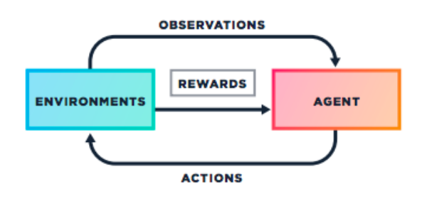
Reinforcement Learning
Agent: The player/bot that interacts with the environment and makes the decisions
Environments: The environment that the agent interacts with
Actions: The action performed by the agent
Observations: The new states after the actions are carried out
Rewards: The value that the agent tries to maximize during training of the agent
Notes:
https://medium.com/@samsam23122001/reinforcement-learning-deep-q-learning-749f212fc73b

Slide 4
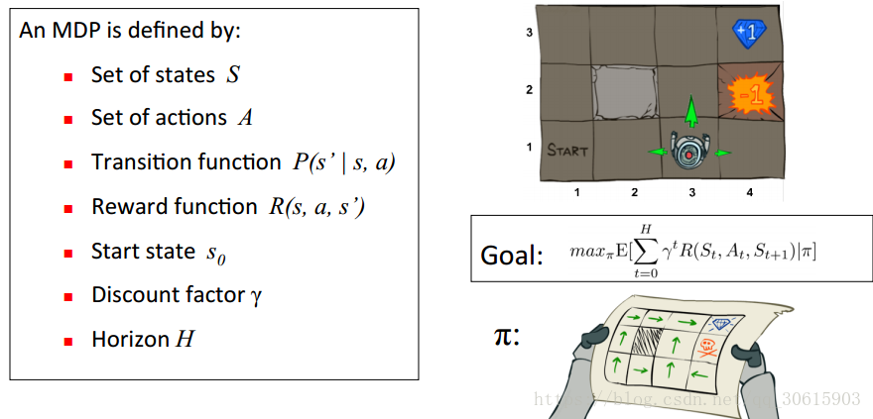
Markov Decision Process

Slide 5
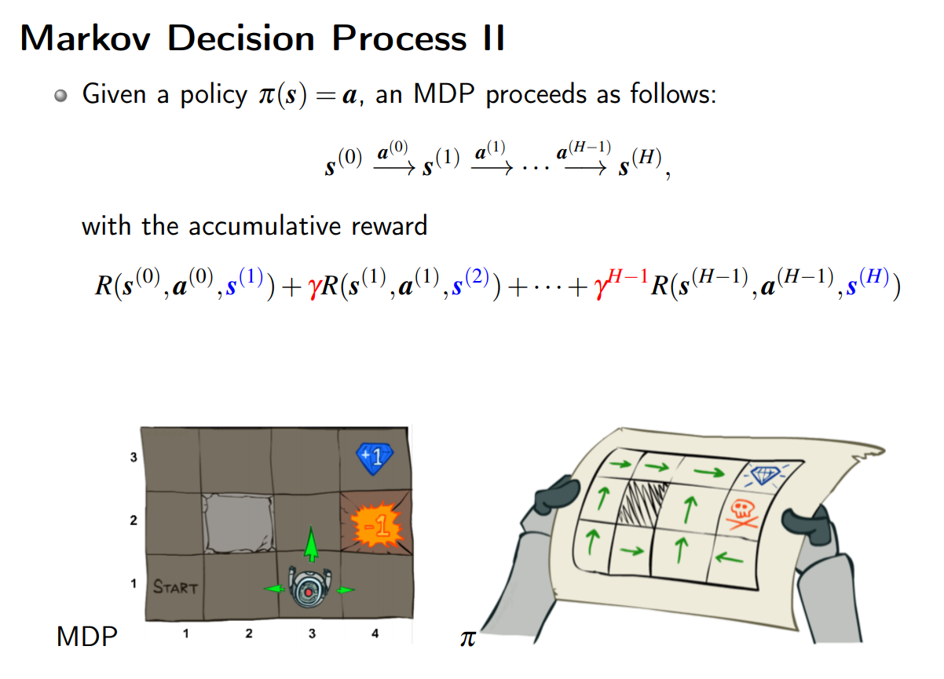

Slide 6
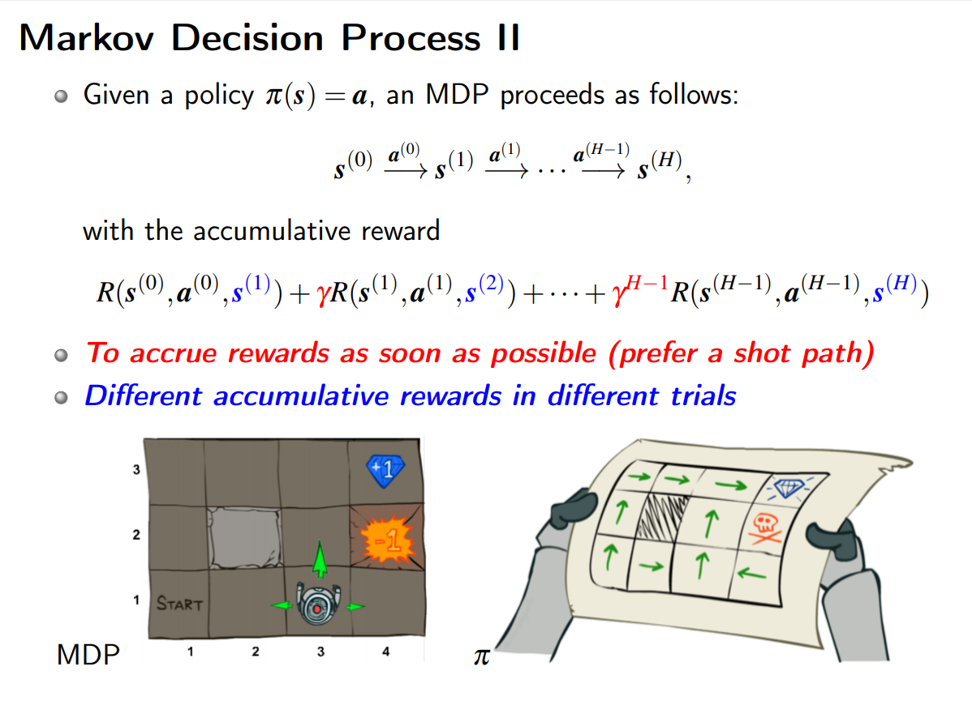

Slide 7
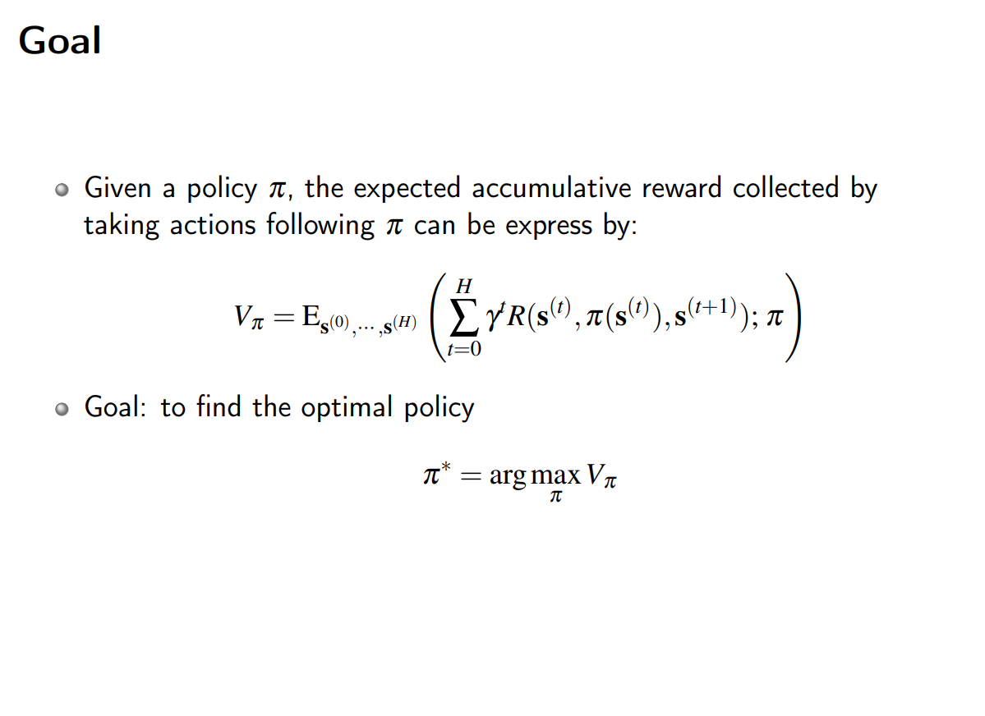

Slide 8
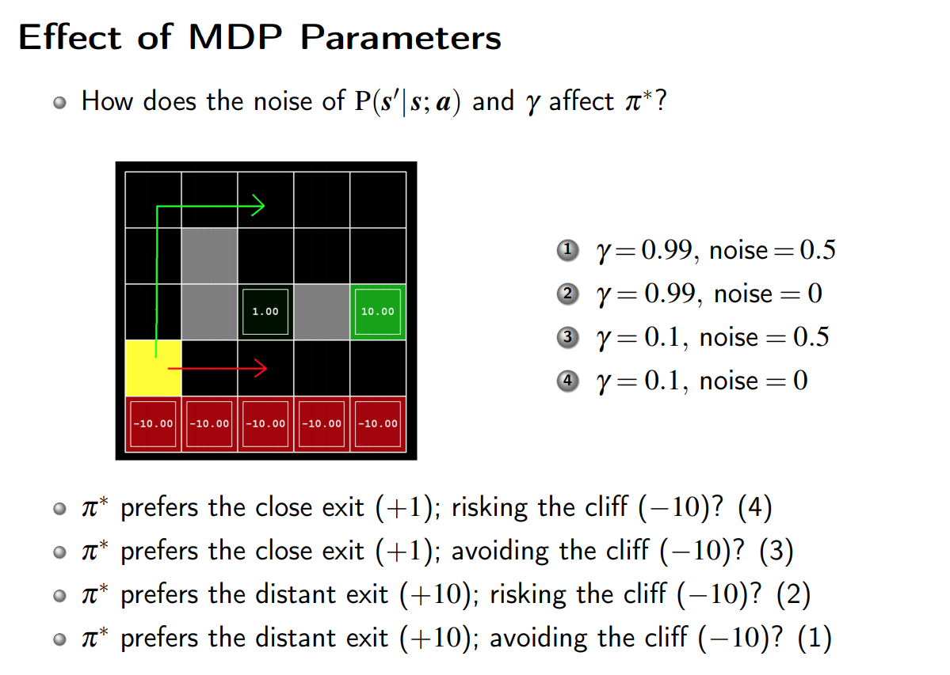

Slide 9
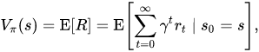
Value Function
Value function is defined as the expected reward starting with state

Slide 10
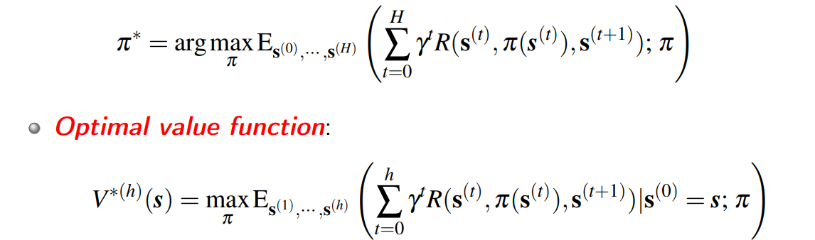
Optimal Value Function

Slide 11
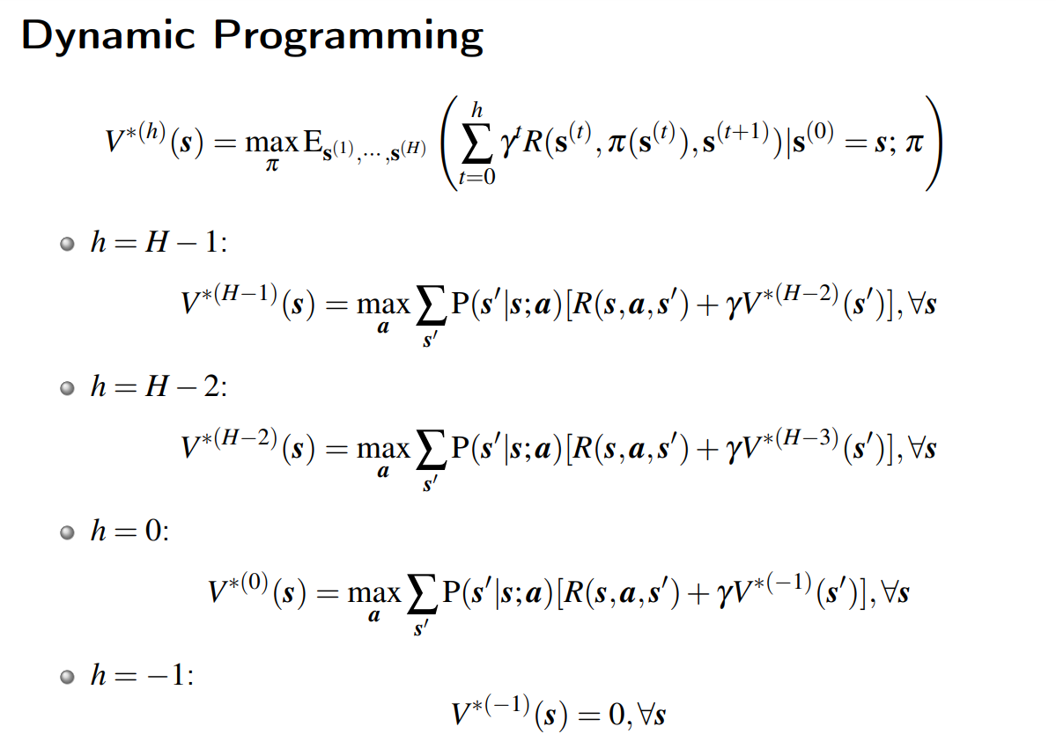

Slide 12
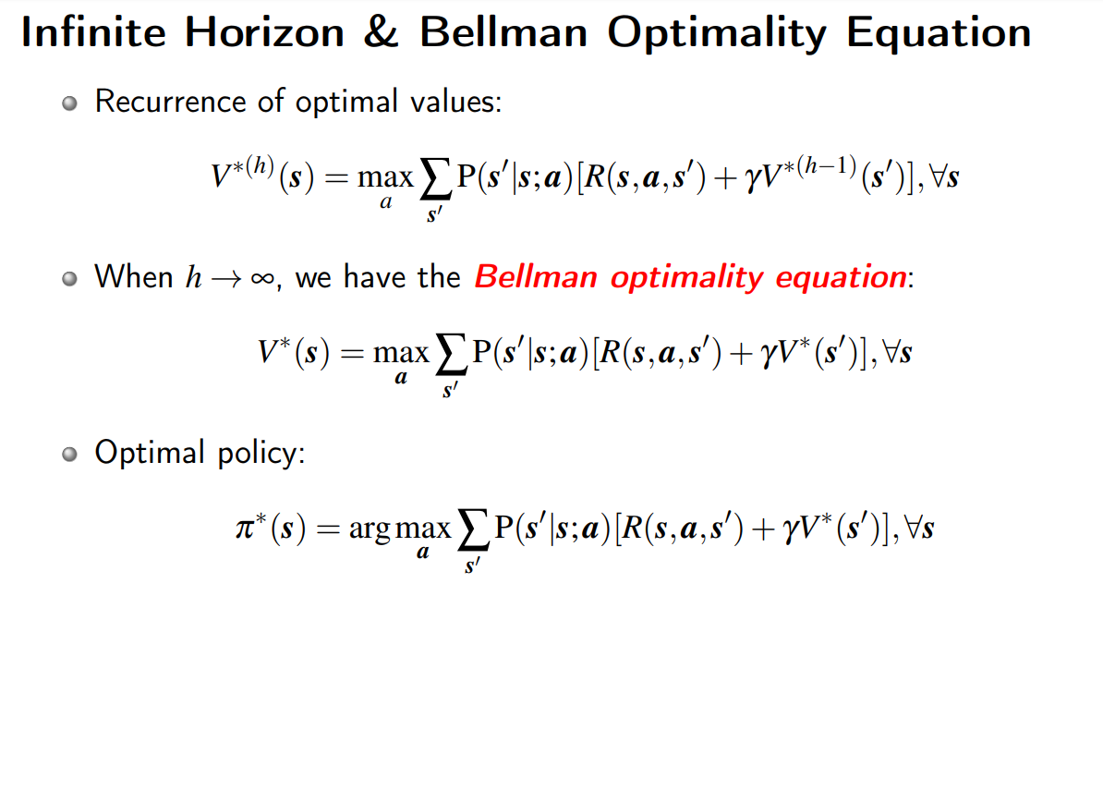

Slide 13
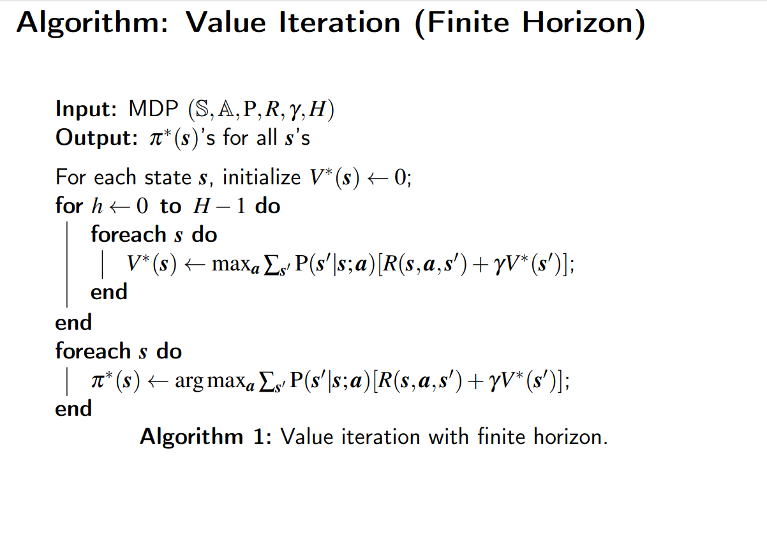

Slide 14
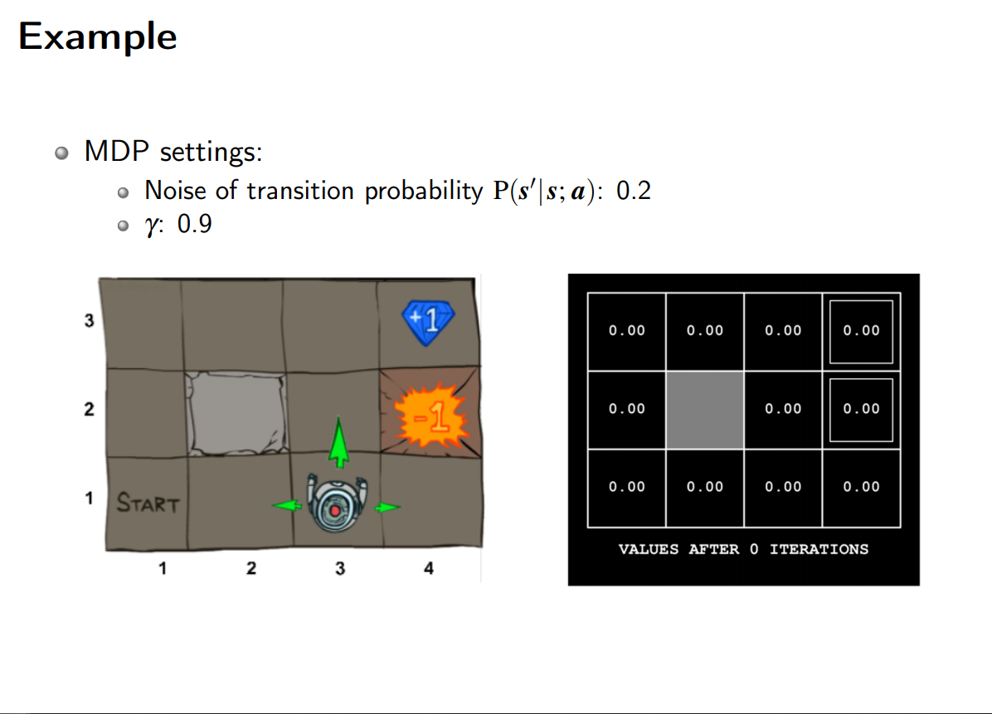

Slide 15
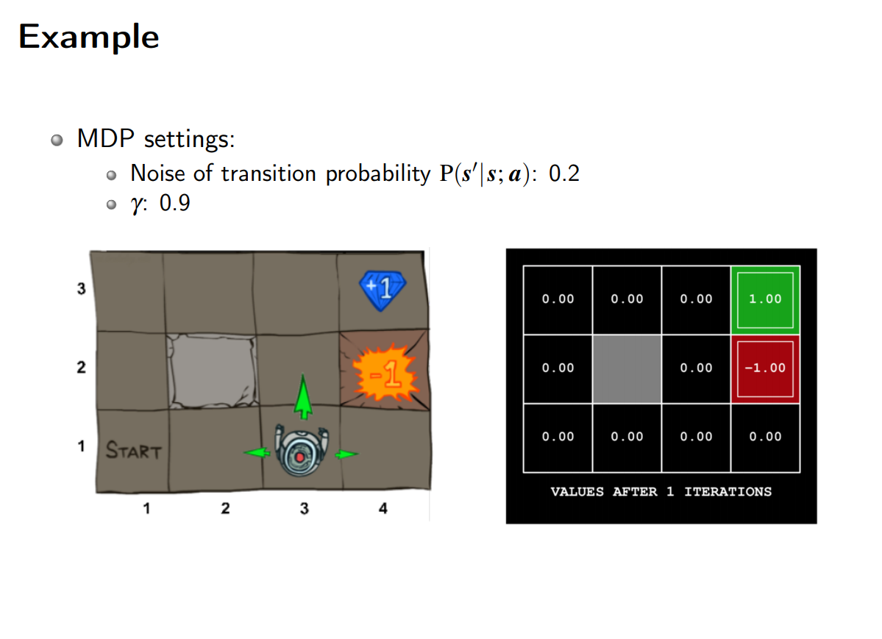

Slide 16
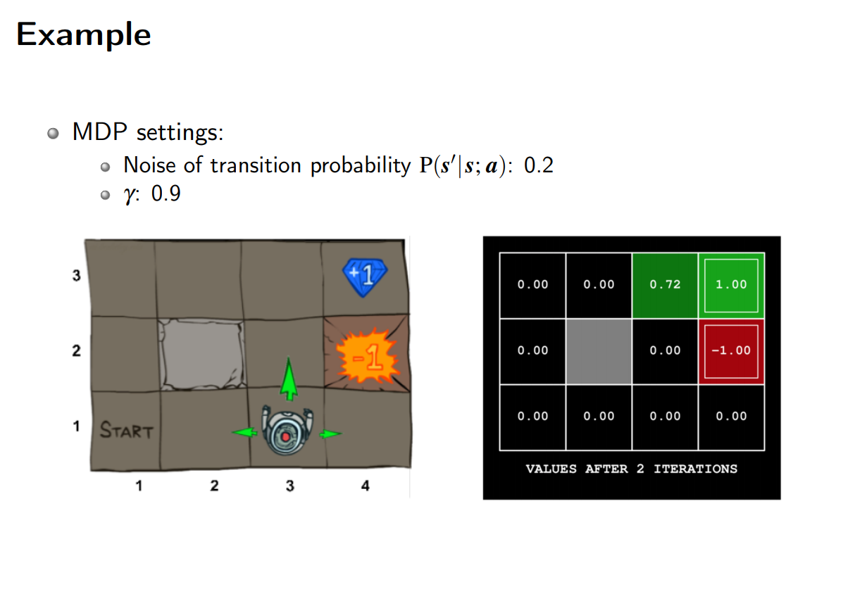
V(3,3)=0.8*[0+0.9*1.00]=0.72

Slide 17
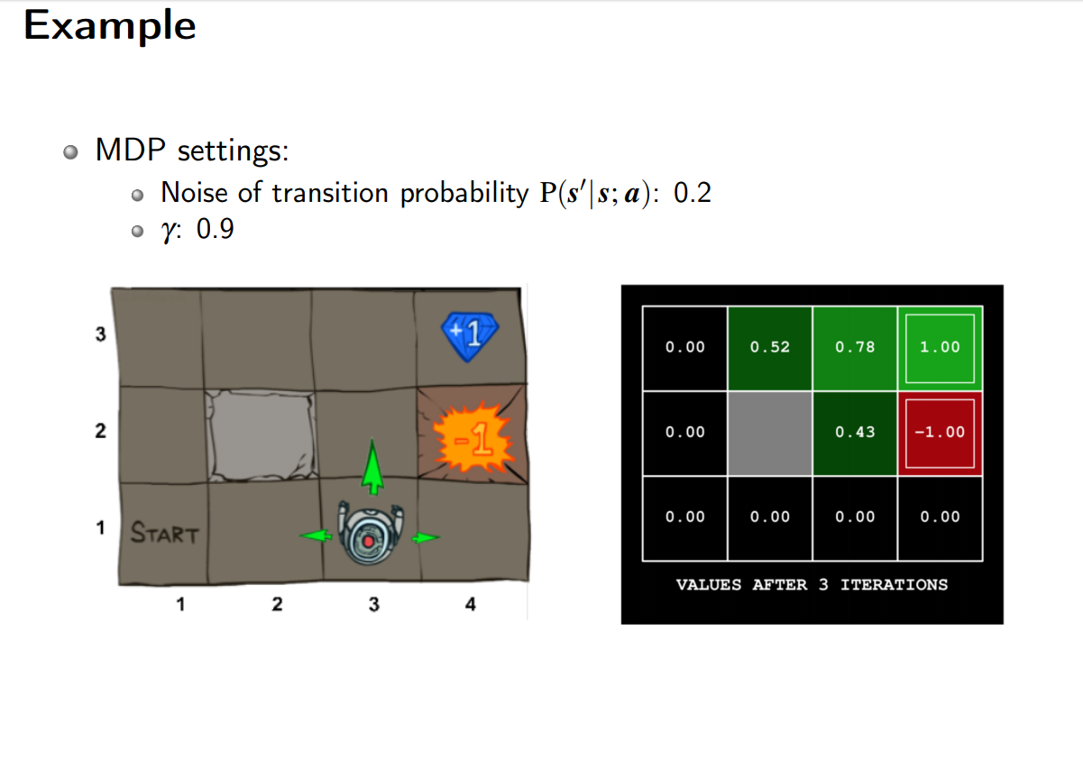
V(2,3)=0.8*[0+0.9*0.72]=0.5184=0.52
V(3,2)=0.8*[0+0.9*0.72]+0.2/2*[0+0.9*(-1.00)]=0.4284=0.43
V(3,3)=0.8*[0+0.9*1.00]+0.2/3*[0+0.9*(0.5184)]+0.2/3*[0+0.9*(0.4284)] =0.776808=0.78

Slide 18
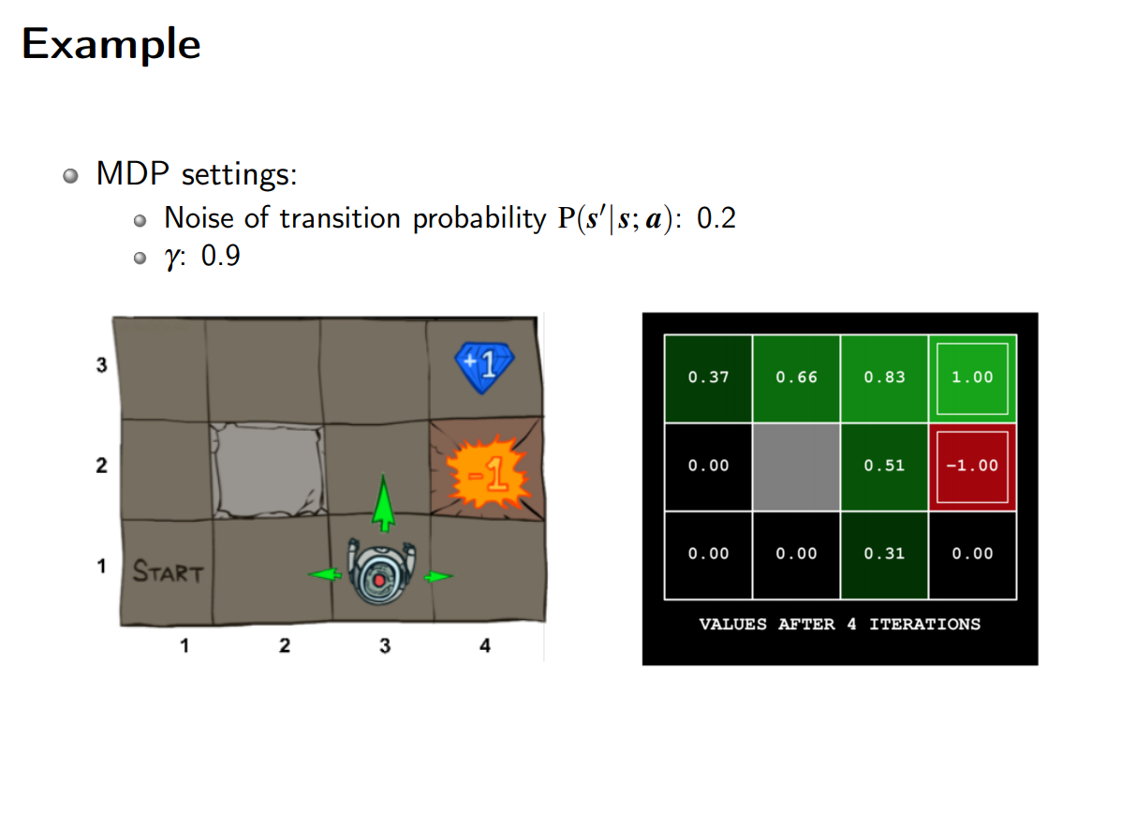
V(1,3)=0.8*[0+0.9*0.5184]=0.373248=0.37
V(3,1)=0.8*[0+0.9*0.4284]=0.308448=0.31

Slide 19
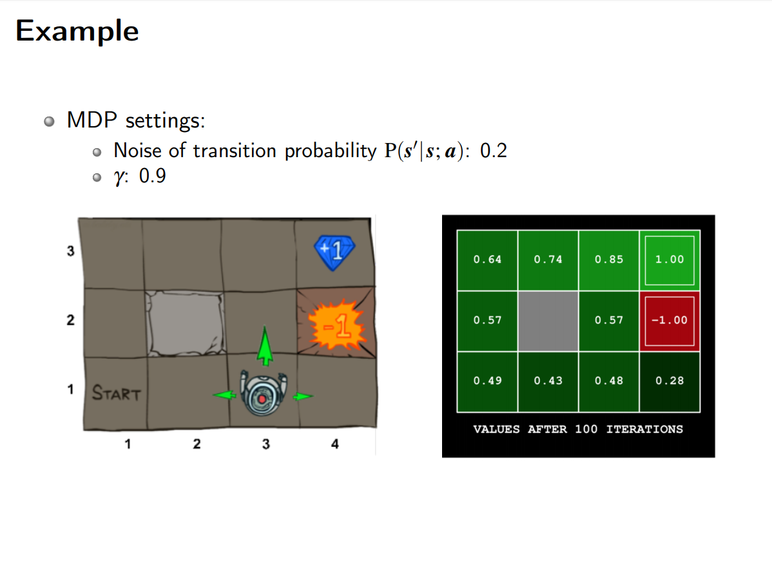

Slide 20
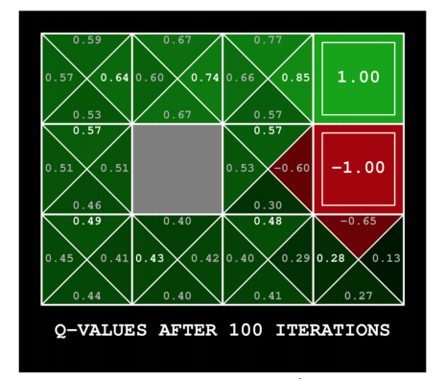
Action-Value Function (Q Function)
is the expected reward starting from state s, following policy π, taking action a

Slide 21
Why Q-learning?
A model-free algorithm is an algorithm which does not use the transition probability distribution (and the reward function) associated with the MDP

Slide 22
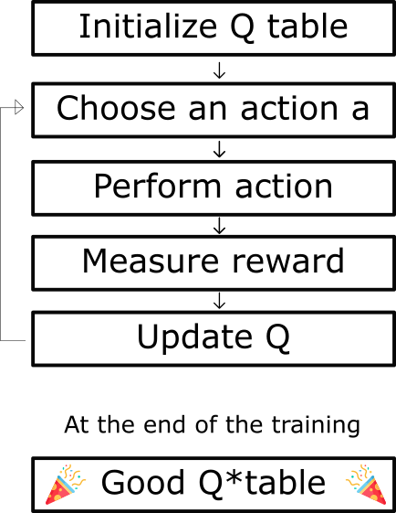
The Q-learning algorithm Process
Notes:
https://www.freecodecamp.org/news/diving-deeper-into-reinforcement-learning-with-q-learning-c18d0db58efe/

Slide 23
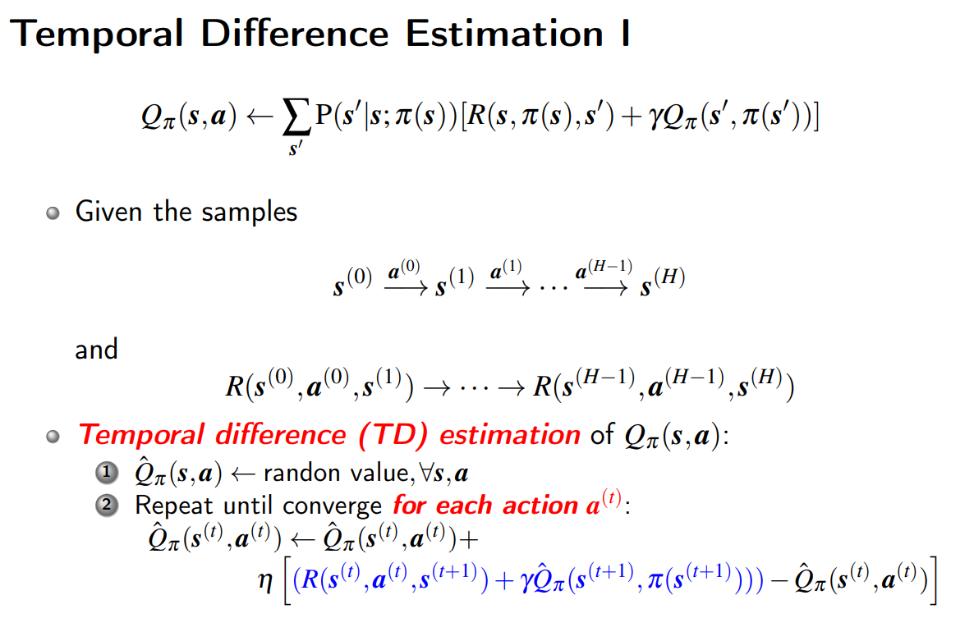

Slide 24
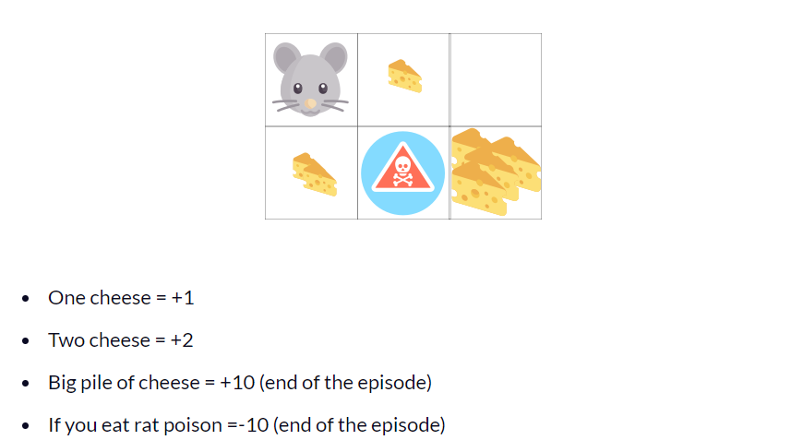
Example
Notes:
https://www.freecodecamp.org/news/diving-deeper-into-reinforcement-learning-with-q-learning-c18d0db58efe/

Slide 25
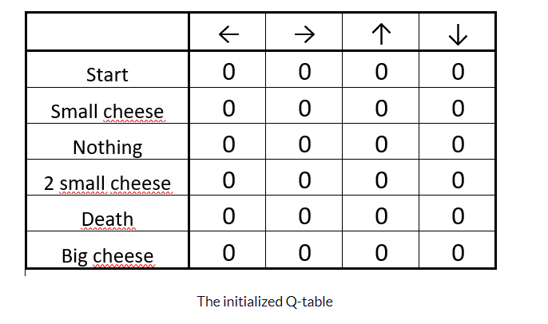
Initinalized Q table

Slide 26
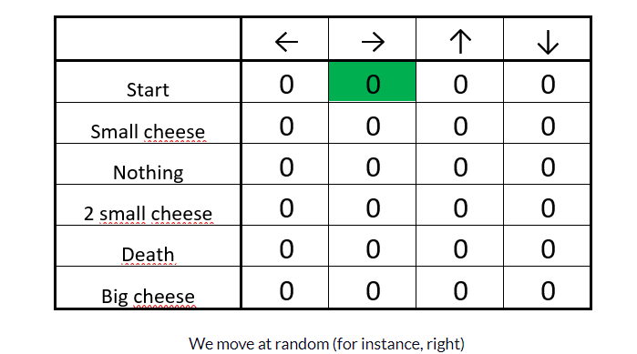
Choose an Action a

Slide 27
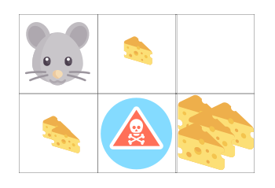
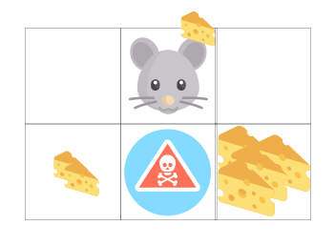
Perfomance Action

Slide 28
Measure Reward
One cheese = +1

Slide 29
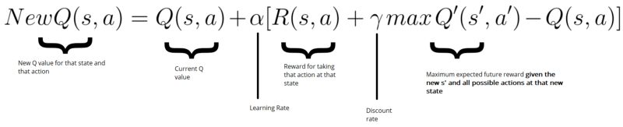
Update Q
Bellman equation

Slide 30
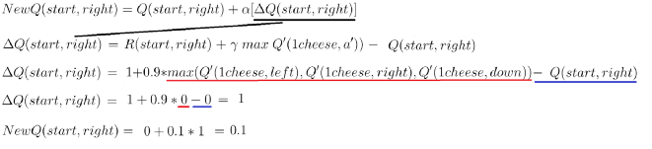
Update Q
Bellman equation

Slide 31
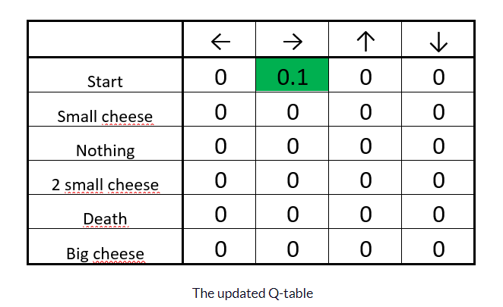
Update Q

Slide 32
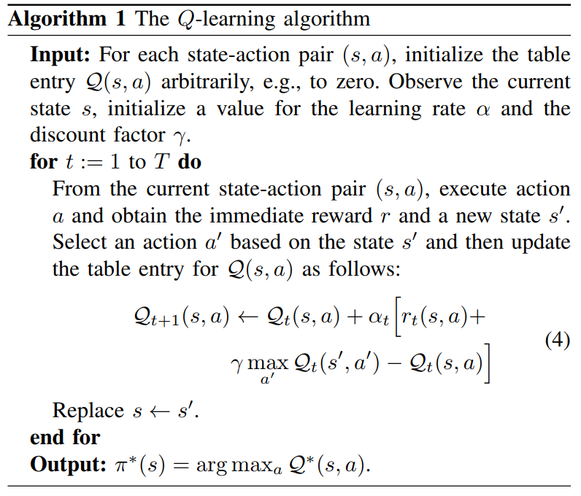

Slide 33
Why use Deep Q-Netowrk?
Space complexity for Q-learning: O(|S|*|A|)
Store Q(s,a)’s for all (s,a) combinations
May not be able to visit all (s,a)’s in limited tranining time
Train a (deep) regressor for Q(s,a)
Space reduction due to the generalizability of the regressor
Notes:
1.In realistic environments with large state/action space, requires a large table to store Q ∗/Qπ values
2.May not be able to visit all (s,a)’s in limited training time
Idea: to learn a function fQ∗ (s,a;Θ) (resp. fQπ ) that approximates Q ∗ (s,a) (resp. Qπ (s,a)), ∀s,a
1.Trained by a small number of samples
2.Generalizes to unseen states/actions
3.Smaller theta to store

Slide 34
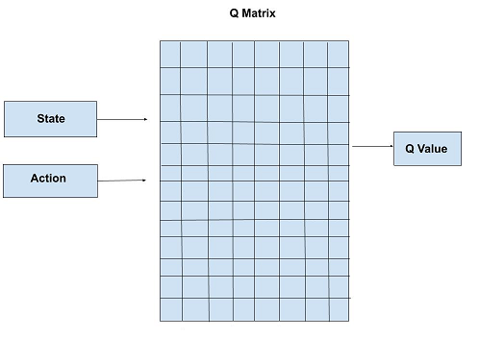
Q-learning (Tabular)
Notes:
1.In realistic environments with large state/action space, requires a large table to store Q ∗/Qπ values
2.May not be able to visit all (s,a)’s in limited training time

Slide 35
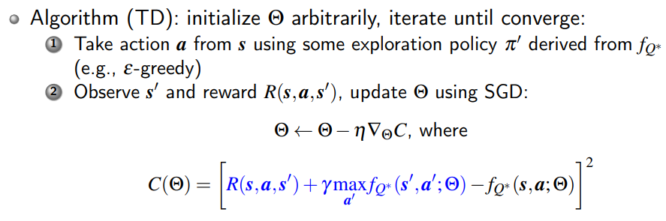
Deep Q-Network
Idea:
To learn a function fQ (s,a;Θ) that approximates Q(s,a) , ∀s,a
1. Trained by a small number of samples
2. Generalizes to unseen states/actions
3. Smaller Θ to store

Slide 36
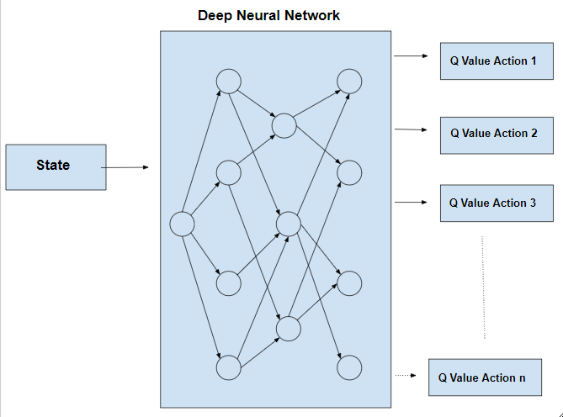
Deep Q-Network
Notes:
Idea: to learn a function fQ∗ (s,a;Θ) (resp. fQπ ) that approximates Q ∗ (s,a) (resp. Qπ (s,a)), ∀s,a
1.Trained by a small number of samples
2.Generalizes to unseen states/actions
3.Smaller theta to store

Slide 37
Fixed Target Q-Network
In the training process, the Q-value will be shifted.
Thus, the value estimations can be out of control if a constantly shifting set of values is used to update the Q-network.
This leads to the destabilization of the algorithm.
To address this issue, the target Q-network is used to update frequently but slowly the primary Q-networks’ values.
In this way, the correlations between the target and estimated Q-values are significantly reduced, thereby stabilizing the algorithm

Slide 38
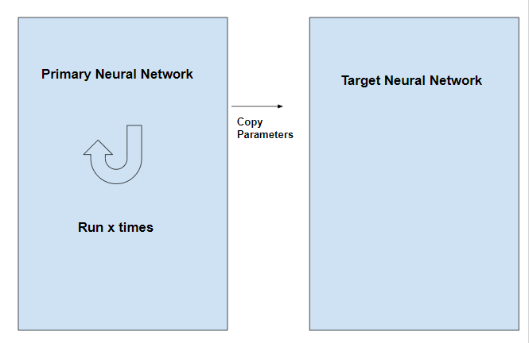

Slide 39
Experience Replay Mechanism
The algorithm first initializes a replay memory D,
i.e., the memory pool, with transitions (st, at, rt, st+1),
i.e., experiences, generated randomly, e.g., through using ϵ-greedy policy.
Then, the algorithm randomly selects samples,
i.e., minibatches, of transitions from D to train the DNN.
The Q-values obtained by the trained DNN will be used to obtain new experiences,
i.e., transitions, and these experiences will then be stored in the memory pool D.

Slide 40
Experience Replay Mechanism
This mechanism allows the DNN trained more efficiently by using both old and new experiences.
In addition, by using the experience replay, the transitions are more independent and identically distributed, and thus the correlations between observations can be removed.

Slide 41
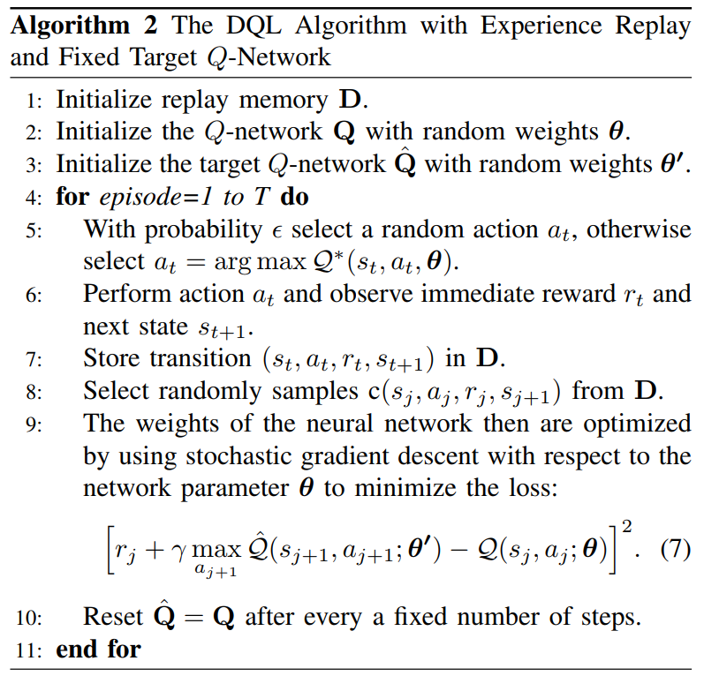

Slide 42
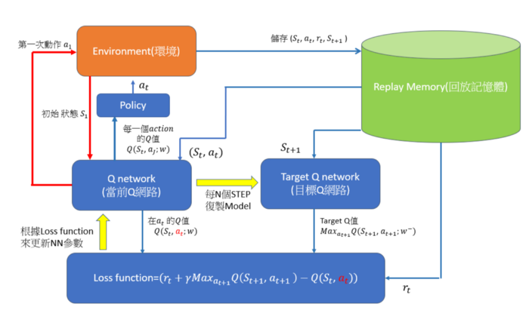
DQN

Slide 43
Double DQN
In some stochastic environments, the Q-learning algorithm performs poorly due to the large over-estimations of action values.
These overestimations result from a positive bias that is introduced because Q-learning uses the maximum action value as an approximation for the maximum expected action value.
The reason is that the same samples are used to decide which action is the best,
i.e., with highest expected reward, and the same samples are also used to estimate that action-value.

Slide 44
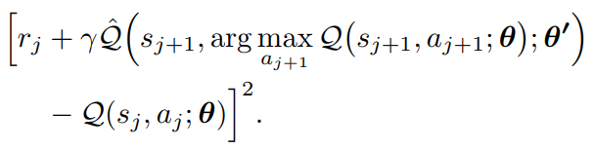
DDQN
Loss Function:

Slide 45
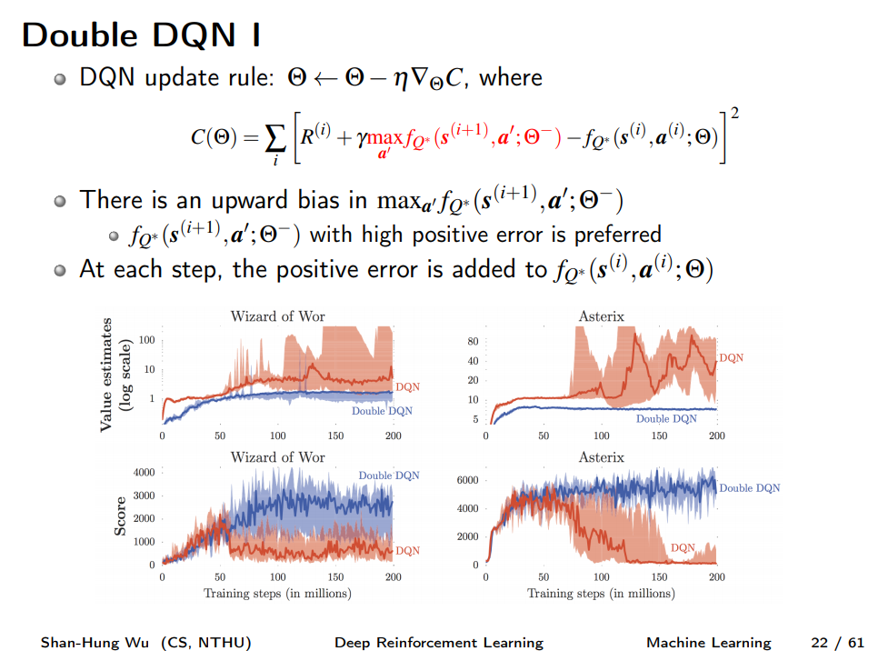

Slide 46
